Slide 1
Group members
Archana Mannam
Sai Supraja Ganta
Oluwatomisin Ajayi

Slide 2
Reinforcement Learning in Gridworld and Pacman: Performance Analysis of
Q-Learning vs Value Iteration

Slide 3
STATEMENT OF OBJECTIVES
This project explores how two foundational reinforcement learning techniques Q-Learning and Value Iteration—perform when training an agent in simulated game environments. Using Python RL framework, we aim to evaluate which method leads to faster and more optimal decision-making.
Objectives
The primary objectives of this project are to:
Train RL agents using Q-Learning and Value Iteration in both Gridworld and Pacman environments.
Compare agent performance based on standard reinforcement learning metrics like cumulative reward and policy convergence.
Investigate how algorithmic design impacts learning in static (Gridworld) versus adversarial (Pacman) environments.
Document and present findings in a structured report and presentation.

Slide 4
Approach
Tools & Environment:
Programming language: Python
Techniques Used:
Q-Learning (Model-Free RL):
Learns optimal action-value function directly through interaction.
Value Iteration (Model-Based RL):
Uses full knowledge of environment transitions to derive optimal policy.
Implementation Plan:
Set up and configure base agents.
Run experiments with varying parameters (discount, learning rate).
Log agent performance over multiple episodes.
Visualize and compare learning behavior.

Slide 5
Deliverables
Deliverable | Description | Purpose
✅ GitHub Repository | Source code, documentation, experiment scripts | Public, verifiable implementation
✅ Experiment Logs | Data on agent performance across episodes | For analysis and visualization
✅ Data Visualizations | Graphs of rewards, convergence, win/loss rates | To support performance insights
✅ Final Report (PDF) | Written summary with background, methods, results | Academic submission deliverable
✅ Presentation Slides | Condensed version of findings | Final oral presentation material

Slide 6
Evaluation Methodology
How We Measure Success:
The following criteria will help evaluate whether we have met the project objectives:
Key Metrics:
Cumulative Reward per Episode
Convergence Time (episodes to stability)
Success Rate (for Pacman)
Episode Length
Objective | Evaluation Method
Train and test both agents | Verify correct implementation and execution in Python
Compare performance | Use key RL metrics: reward, convergence rate, episode length
Understand algorithm behavior | Analyze logged data and visual learning trends
Produce actionable insights | Summarize findings in a formal report and class presentation

Slide 7
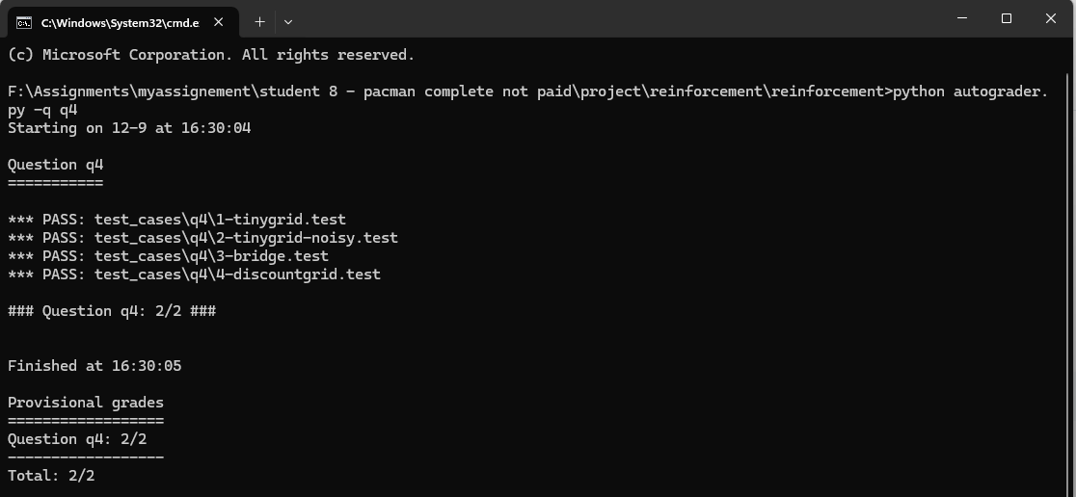
Results
Value Iteration in Gridworld

Slide 8
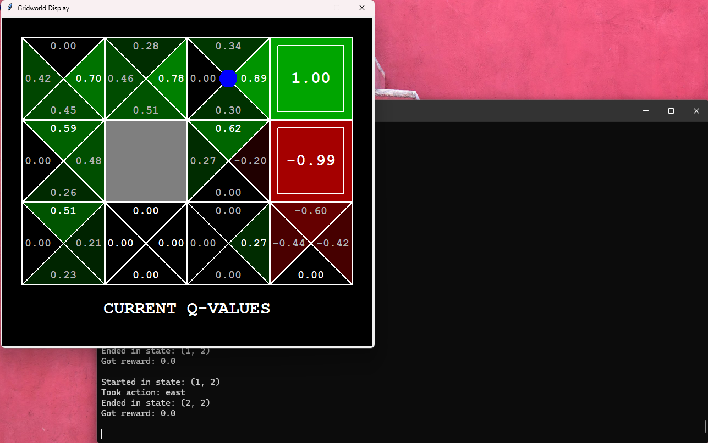
Results
Q-Learning in Gridworld
Purpose
Evaluate model-free learning in a simple environment.
Expected Behavior
Initial average reward: −0.25
Reward after ~50 episodes: +0.08
Slower but steady convergence

Slide 9
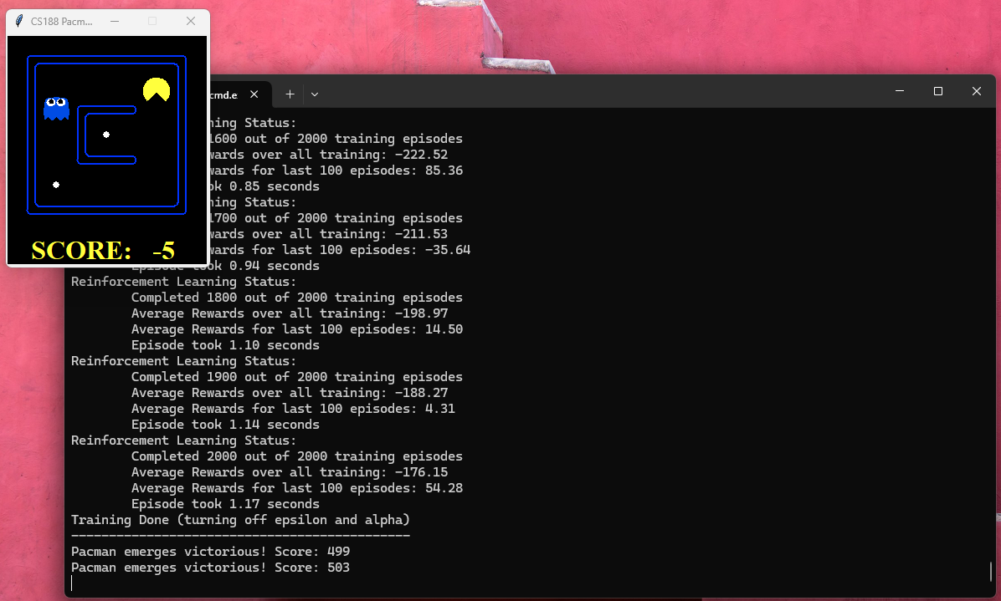
Results
Q-Learning in Pacman (SmallGrid)
Purpose
Study learning efficiency in a simple, partially adversarial maze.
Expected Behavior
Rewards improve from −510 → −159 over 2000 episodes
Testing scores consistently exceed 495
Visual movement becomes efficient and stable

Slide 10
Conclusion
Value Iteration is the fastest and most stable in deterministic environments like Gridworld.
Q-Learning adapts well to stochastic and adversarial environments like Pacman.
Gridworld highlights the strengths of model-based RL.
Pacman demonstrates the flexibility and robustness of model-free RL.
All experimental findings align with theoretical expectations in reinforcement learning.
The project meets all planned objectives. Results are verified through logs, autograder outputs, and visual demonstrations.

